Slide 1
Eastern Shore Sanitary Sewer Transmission Force Main Project - Phase 1
Overview for Eastern Shore County and Town Municipal Governments

Slide 2
Eastern Shore Sanitary Sewer Transmission Force Main Project - Phase 1
About Eastern Shore Sanitary Sewer Transmission Force Main - Phase 1
The Beginning: The Eastern Shore Sanitary Sewer Transmission Force Main Project was formed at a “Learning the Shore; Discussion on Major Infrastructure Needs” held in April of 2018, when then Congressman Scott Taylor suggested moving forward with development of the specific wastewater treatment and collection needs under the Omnibus Infrastructure Spending Bill passed in 2018-2019.
The discussions:
Spring 2018 – Spring 2019, community stakeholder meetings convened to gain insight and expertise into the standards of practice and the treatment technologies available. Through this process, it was decided that HRSD was the right partner to further help in bringing the Force main Project forward. It was also recognized that, in addition to the mid-Shore’s specific project needs, that the needs of southern Northampton County and northern Accomack County would require evaluation at a later time.
The Study:
HRSD worked with HDR under their annual General Engineering Services contract to develop a project scope and estimate for project design cost, including operation and maintenance costs for the project. HDR engaged the firm of Davis Bowen & Friedel, Inc. an engineering firm familiar with the Eastern Shore.
Project Funding:
The project was funded by a combination of the Phase 1-impacted municipalities and Go Virginia.
The Project Scope:
Phase 1 of this project will connect and serve the existing sanitary sewer collection systems along the route that serves Nassawadox in the southern end of Northampton County north to the Town of Accomac. The existing treatment plant in Onancock has the capacity to treat future flows from these collection systems and from new service areas along the force main route.

Slide 3
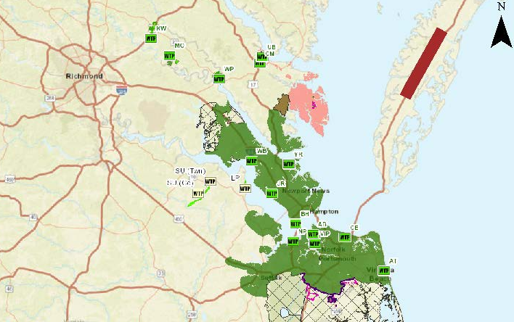
Eastern Shore Force Main Sewer Project Phase 1
Project planning area
Need a better map?

Slide 4
Eastern Shore Sanitary Sewer Transmission Force Main Project - Phase 1 HRSD & the Eastern Shore Joint Venture
After much research and discussion, it was apparent that HRSD was the right partner to align with on this initiative.
Estimated Project Study Cost = $108,458.
11/6/18 HRSD and their consultants toured the Shore WWTP’s in Onancock and Nassawadox.
12/13/18 HRSD and consultants met with Onancock WWTP personnel to begin plant assessment.
12/13/18 HRSD, HDR, DBF presented the Main Force Transmission Line Conceptual Study.

Slide 5
Eastern Shore Sanitary Sewer Transmission Force Main Project - Phase 1
HRSD History
What was created…
A political subdivision of the Commonwealth.
Truly a regional entity – no direct connection to local governments.
Governed by an 8 member Commission appointed by the Governor.
Independent rate setting authority with appeal rights through State Corporation Commission
Very focused mission – We protect public health and the waters of Hampton Roads by treating wastewater effectively.

Slide 6
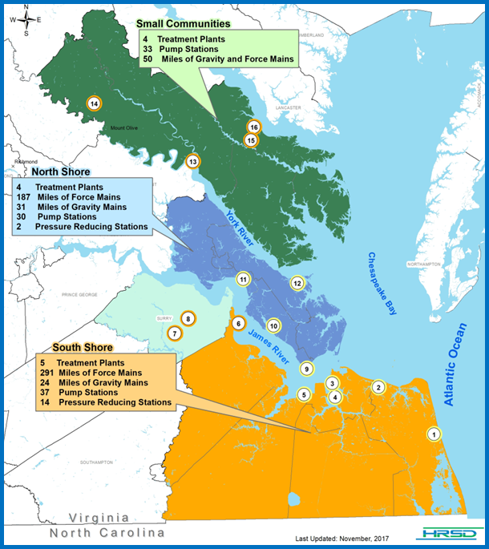
HRSD Existing Service Area
Virginia Beach
Chesapeake
Norfolk
Portsmouth
Suffolk
Hampton
Newport News
York County
James City County
Williamsburg
Poquoson
Gloucester County
Isle of Wight County
King William County
Middlesex County
Mathews County
Surry County/Town of Surry

Slide 7
Eastern Shore Sanitary Sewer Transmission Force Main Project - Phase 1
Rural Counties Currently Serviced by HRSD faced Similar challenges as the Eastern Shore faces
HRSD enabling legislation has provision for adding territory to the sanitation district
5 counties and the Town of West Point have used this process to become part of HRSD over the past 20 years
King William
Middlesex
Mathews
King and Queen
Surry

Slide 8
Eastern Shore Sanitary Sewer Transmission Force Main Project - Phase 1
December 2018 Study funding committed as follows:
$10,000 each from Accomack and Northampton Counties, Town of Onancock and Town of Exmore, Riverside Health Systems and Heritage Hall.
Local Funding Total = $60,000
$48,458 from Go Virginia - first Go Virginia grant to the Eastern Shore.

Slide 9
Eastern Shore Sanitary Sewer Transmission Force Main Project - Phase 1
Transmission Forcemain System & Pump Stations
A proposed transmission force main system will consist of 6- and 12-inch diameter pipe and three pumping stations.
One in Nassawadox at WWTP
One in Exmore
One in Accomac at the County facilities
The force main is sized to convey the projected Year 2050 flows to the Onancock WWTP.
In addition, the existing force main that serves the commercial and government area south of Melfa and the commercial area in Onley will be replaced.
Alternatives have been developed to construct new pump stations and connections to the transmission force main from the Exmore New Roads system and the Onley residential area.
Per Phase 1 Preliminary Design; Subject to Change.

Slide 10
Forcemains Layout Map
Eastern Shore Sanitary Sewer Transmission Force Main Project - Phase 1
The proposed forcemains will be nominal diameter of 6 and 12 inches.
Trenchless technology will be used where the forcemain will need to cross Rt. 13 in order to not affect the flow of traffic.
Any pavement restoration for the installation of the forcemain will be in accordance with VDOT Standards.
Actual alignment will vary from the conceptual design.
Per Phase 1 Preliminary Design; Subject to Change.

Slide 11
Nassawadox Layout Map with Forcemain & Pump Station
Eastern Shore Sanitary Sewer Transmission Force Main Project - Phase 1
A pump station is proposed just upstream of the Nassawadox WWTP. The flows will be conveyed via a 6” forcemain to the Town of Exmore. The Exmore pump station would receive flow from the Nassawadox pump station and then transport the flow to the Onancock WWTP.
Per Phase 1 Preliminary Design; Subject to Change.

Slide 12
Exmore Layout Map with Forcemain & Pump Station
Eastern Shore Sanitary Sewer Transmission Force Main Project - Phase 1
The proposed plan is to replace an existing pumping station in Exmore. The proposed pump station will transmit sewage with a 12’’ forcemain following the railroad right-of-way. The forcemain will pass near Belle Haven, Painter, Keller, Melfa and Onley. Once entering Onley, the forcemain will be routed to the Onancock WWTP.
Per Phase 1 Preliminary Design; Subject to Change.

Slide 13
Accomac Layout Map with Forcemain & Pump Station
Eastern Shore Sanitary Sewer Transmission Force Main Project - Phase 1
In Accomac, the proposed pump station is planned to be placed near the Accomack County government buildings to replace the existing drainfield. The forcemain will be 6’’ in diameter and will run through Tasley on Tasley Road. The forcemain will be connected into the 12’’ forcemain from Nassawadox and Exmore and be transported to the Onancock WWTP.
Per Phase 1 Preliminary Design; Subject to Change.

Slide 14
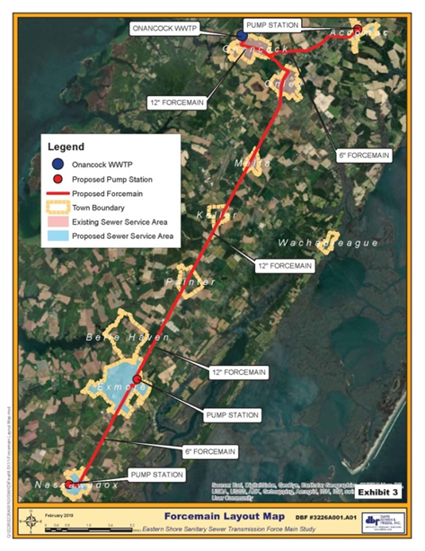
Eastern Shore Sanitary Sewer Transmission Force Main Project - Phase 1
Summary of the story
Smaller treatment plants challenged to keep staff, meet permit requirements, reinvest in aging facilities.
Study of central sewer pipe to connect Nassawadox, Accomac and Exmore to Onancock WWTP.
Would consolidate treatment for the middle ES and take advantage of capacity at Onancock.
$24 Million estimate to construct.
$75,000 per year to operate and maintain.
Who would own and operate?
HRSD could own and operate the Project if the Eastern Shore becomes part of the Hampton Roads Sanitation District.
Who would fund construction?
HRSD could fund the construction of the Project if the Eastern Shore becomes part of the Hampton Roads Sanitation District .
Per Phase 1 Preliminary Design; Subject to Change.
Pipeline along the Shore and how many it will serve

Slide 15
Eastern Shore Sanitary Sewer Transmission Force Main Project - Phase 1
HRSD – How it Works
Becoming part of the territory is the first step. Nothing changes until the petition to amend the District that comprises HRSD is acted upon by the 2nd Circuit Court of the Commonwealth.
Today, local sewer services continue to be owned and operated by local municipal government or private entities such as the Riverside plant at Nassawadox.
If the 2nd Circuit rules favorably and amends the enabled District of HRSD, local governments then have options available: a joint operating agreement may be signed by each locality to contract HRSD to a) convey and treat the wastewater from their system, and b) operate the collection system for the municipal customers.
Individual operating agreements establish transfer of assets and execute right of way transfers.
Historically all added territories have transferred their sewer assets to HRSD and HRSD is now fully responsible for collection, conveyance and treatment of sanitary sewer in these communities.
Regardless, local governing body retains full control of land use decisions.

Slide 16
Eastern Shore Sanitary Sewer Transmission Force Main Project - Phase 1
Project Milestones
Winter 2018 – Spring 2019: HDR evaluation of the Force Main Transmission Line
April 2019: HDR/HRSD Summary of the Evaluation Report to the Eastern Shore Force Sewer Transmission Committee
June 17, 2019: Planning and preparation for the public information sessions conducted
August 14-15, 2019: Public Information Sessions conducted in Accomack and Northampton Counties
October 24, 2019: Town Council and Accomack/Northampton County Supervisors combined meeting
November 2019 – December 2019: Further study by towns & counties for evaluating diligence
January 2020 - June 2020: Petition of the 2nd Circuit Court by Accomack and Northampton Counties to amend HRSD Enabling Act
November 2019 - April 2020: Plan of Finance Prioritization with Project Sources
January 2020 - June 2020: Joint Operating Agreement Negotiation and Execution
May 2020 - December 2020: Project Sources Contracted
January 2021 - April 2021: Transmission Line Procurement (Request For Proposal)
April 2021 - April 2023: Transmission Line Construction

Slide 17
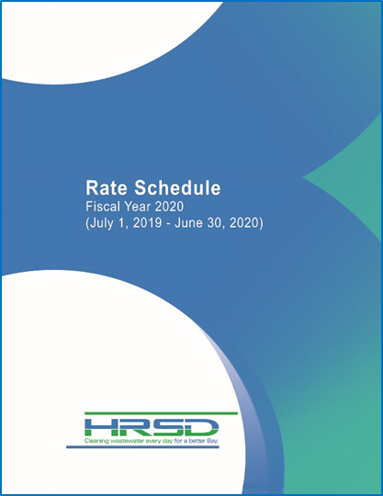
Eastern Shore Sanitary Sewer Transmission Force Main Project - Phase 1
A single treatment rate is established for an entire service area:
Total cost to convey and treat divided by total expected amount of water consumed in the region – FY 2023 $10.15/1,000 gallons. This is an estimate only; see your respective Town Manager for debt recovery fees that may apply. We have yet to decide how debt is to be apportioned, in particular Onancock’s plant debt of $4.5M. A cursory allocation of this debt among all project participants based on day one flow comes out to an additional $3.33 to be added per 1,000 gallons of.
A collection system maintenance rate for HRSD owned collection systems is established as the average charged by localities with collection systems within service area. Population weighted average – FY 2023 $5.78/1,000 gallons. This is an estimate only; see your respective Town Manager for debt recovery fees that may apply.
Total FY 2023 Rate $15.93/1,000 gallons. This is an estimate only; see your respective Town Manager for fees that may apply.
For specific questions regarding your town, contact:
Town of Onancock (William H. Kerbin, Jr. ,Town Manager (757) 787-3363)
Accomack County and all other Accomack County Towns (Stewart Hall, Deputy County Administrator (757) 787-5700)
Town of Exmore (Robert G. Duer, Town Manager (757) 442-3114, ext. 13)
Northampton County and all other Northampton County Towns (Charles Kolakowski , County Administrator (757) 678-0440, x515)

Slide 18
Eastern Shore Sanitary Sewer Transmission Force Main Project - Phase 1
Example:
Petition of the Circuit Court of Virginia: IN THE CIRCUIT COURT FOR THE COUNTY OF SURRY
IN THE MATTER OF THE PETITION OF THE HAMPTON ROADS SANITATION DISTRICT COMMISSION, A POLITICAL SUBDIVISION OF THE COMMONWEALTH OF VIRGINIA, TO ADD THE ENTIRE GEOGRAPHICAL BOUNDARY OF THE COUNTY OF SURRY, VIRGINIA TO SAID DISTRICT PURSUANT TO § 21-291.2 OF THE 1950 CODE OF VIRGINIA, AS AMENDED, INCORPORATING BY REFERENCE CHAPTER 66 OF THE 1960 ACTS OF ASSEMBLY, AS AMENDED.
Petition
COMES NOW the Petitioner, the Hampton Roads Sanitation District (“HRSD” or the “District”), through its duly appointed Commission (the “Commission”), by counsel, who represents to the Court as follows:
This Petition is filed pursuant to Chapter 66, § 48, of the 1960 Acts of Assembly as incorporated by reference in § 21-291.2 of the 1950 Code of Virginia, as amended;

Slide 19
Eastern Shore Sanitary Sewer Transmission Force Main Project - Phase 1
Excerpt from existing HRSD Service Operating Agreement:
Any easements or other properties wherein water utility facilities are currently located shall be available without additional compensation for continued use by the COUNTY for the operation and maintenance of the COUNTY’S water utility facilities. If any easements or other properties have been previously conveyed to the County for combined water and sewer utility purposes and no water facilities have been constructed as of the date of recordation of the deed of conveyance to HRSD, then such easements or properties shall be available without additional compensation for use by the COUNTY for water utility facilities only with the written approval of HRSD provided that HRSD shall not unreasonably withhold approval if HRSD’s use and enjoyment of the easement is not negatively impacted by the proposed COUNTY water facilities and appropriate separation can be maintained between water and sanitary sewer facilities within the same easement.
HRSD shall maintain and operate the sewer collection system, interceptor system and all treatment facilities in accordance with all applicable laws and regulations. HRSD will strive to meet the following levels of service:
a. Treatment Facilities: Permit compliance for 99 percent of all permit parameters in a calendar year.
b. Interceptor System Facilities: Investigation into system failures and/or overflows within 2 hours of notification. Corrective action to remediate as soon as possible thereafter.
c. Collection System Facilities: Investigation into system failures and/or overflows within 4 hours of notification. Corrective action to remediate as soon as possible thereafter.
d. System Odors: Investigation into source and or cause of odor complaints within 4 hours of notification on regular business hours or as soon as possible after notification during non-business hours. Corrective action to remediate as soon as possible thereafter.
This AGREEMENT may be terminated by the TOWN with 12 months written notice. TOWN shall reimburse HRSD for all facilities constructed by HRSD based on current depreciated value as carried on HRSD’s last Comprehensive Annual Financial Report. HRSD will return all of the property transferred by the TOWN to HRSD when this Agreement was executed (the Facilities) at no cost to the TOWN. Upon termination the TOWN shall assume all regulatory liability for all sewer facilities within the TOWN.
This AGREEMENT may be not be terminated by HRSD without the express written consent of the TOWN.

